Slide 1

Submitted By :
Aditya Bhatt 23SCSE1410086
Bhaskar raj 23SCSE1410019
Bhavishya Kaushik 23SCSE1410002

Slide 2

Employee Management System: MySQL
This presentation explores the development of an Employee Management System (EMS) using Node.js and MySQL. We'll delve into the system's features, design, implementation, and usage, highlighting its key functionalities and benefits.

Slide 3
Project Overview
Purpose
Key Features
The EMS streamlines employee data management, enabling organizations to efficiently track information, roles, departments, and salaries.
The system allows users to view, add, update, and manage employee data, departments, and roles.

Slide 4
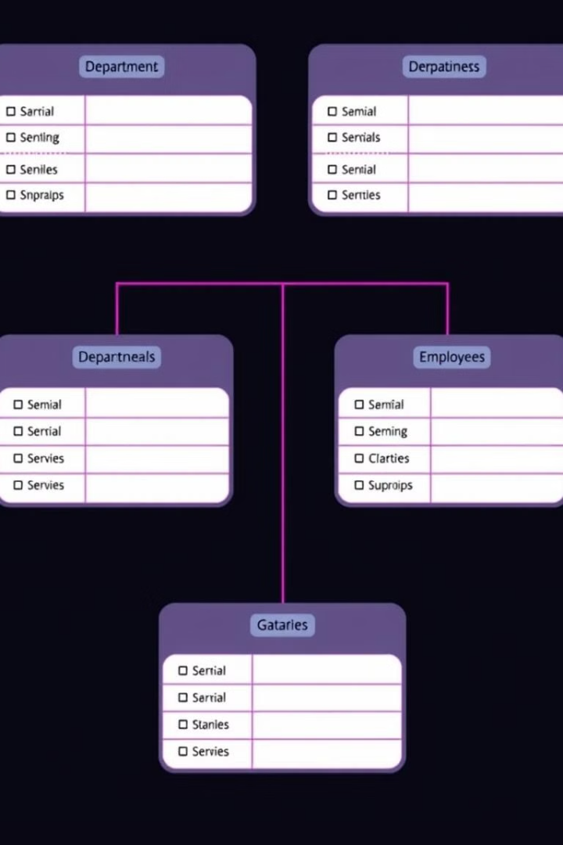
System Design: Database Schema
Departments
Roles
Stores department information, including department name and ID.
Contains job roles, each linked to a department, including job title, role ID, salary, and department.
Employees
Holds employee details, including employee ID, first name, last name, role, salary, manager, and department.

Slide 5
System Design: Application Architecture
Database Layer
User Interface Layer
Controller Layer
Handles connections and queries to the MySQL database, ensuring secure and efficient data access.
Manages command-line prompts and displays information to the user, providing a user-friendly interface for interaction.
Processes user inputs and interacts with the database layer to perform CRUD operations, ensuring data integrity and consistency.

Slide 6
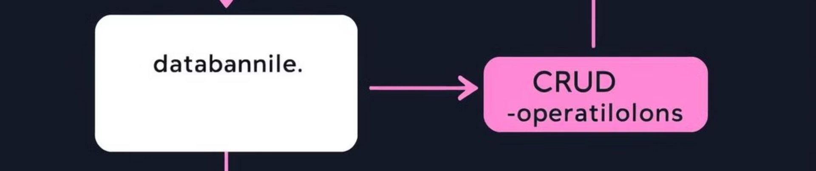
Implementation Details: Key Modules
1
Database Connection
2
User Prompts
3
CRUD Operations
Utilizes the `mysql2` package to connect to the MySQL database, ensuring reliable and secure data access.
Employs `inquirer` to present options and gather user inputs, providing a user-friendly and interactive experience.
Implements functions to create, read, update, and delete records in the database, ensuring data integrity and consistency.

Slide 7





Implementation Details: Technologies Used
Node.js
MySQL
JavaScript runtime for building the server-side application, providing a powerful and flexible platform for development.
Relational database management system for storing employee data, ensuring data integrity and scalability.
Inquirer
Dotenv
Node.js package for creating interactive command-line prompts, enhancing user experience and interaction.
Module to load environment variables from a `.env` file, ensuring secure configuration management.

Slide 8
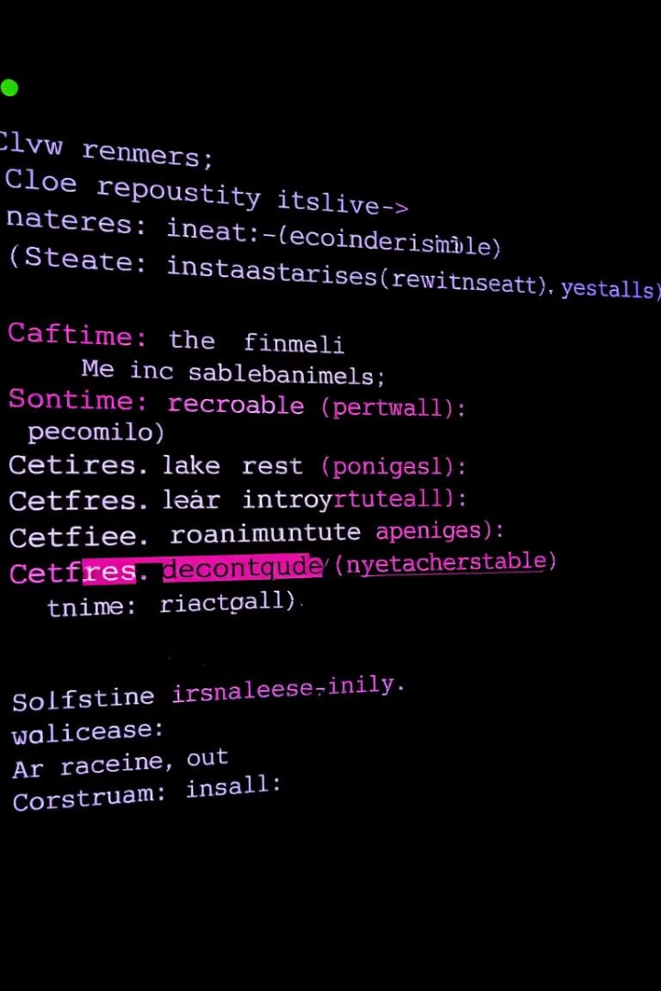
Installation and Setup
To set up the application, follow these steps: clone the repository, navigate to the project directory, install dependencies, configure environment variables, and initialize the database using the provided SQL scripts.

Slide 9

Conclusion
The Employee Management System provides a robust solution for managing company employee data through a command-line interface. By leveraging Node.js and MySQL, the application ensures efficient data handling and scalability, empowering organizations to effectively manage their workforce.

Slide 10
Thank You

